Slide 1

UNIT TESTING A-Z
WITH PETER

Slide 2
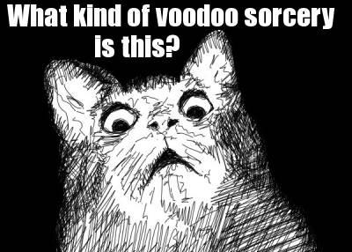
UNIT TESTING IS NOT VOODOO!

Slide 3
TESTING IS EVOLVING
FUMBLING
AROUND
USING
OTHERS
CODE
MODIFYING
OTHERS
CODE
CREATING
SCRIPTS
CREATING
MODULES
CREATING
TOOLS
POWERSHELL
DEVELOPER

Slide 4
WORKSHOP SUMMARY
1ST
HALF
BREAK
2ND
HALF
Introduction to unit testing
Begin Project
Test Design
Pester Syntax

Slide 5

ASSUMPTIONS
POWERSHELL SKILLS
NO EXPERIENCE
WITH PESTER

Slide 6
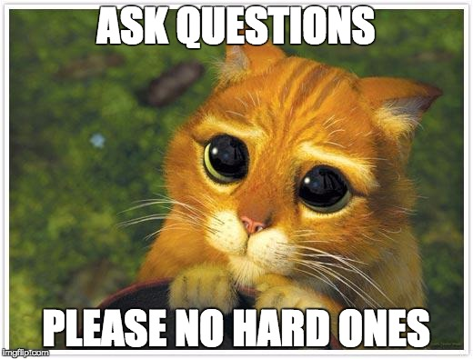
QUESTIONS

Slide 7
TESTING “LAYERS”
ACCEPTANCE TESTS
ITEGRATION TESTS
UNIT TESTS

Slide 8

UNIT TESTS
SMALL
HAVE NO
DEPENDANCIES
THEY
TEST
DO NOT TOUCH THE
ENVIRONMENT
Code
Input/Execution
/Output

Slide 9
PESTER SYNTAX
DESCRIBE
BLOCKS
IT
BLOCKS
ASSERTIONS

Slide 10
BENEFITS OF UNIT TESTING
THE BIG
RED BUTTON
CREATES A "SNAPSHOT" IN TIME
DEFINES "WORKING"
PREVENTS REGRESSION BUGS
ENABLES TRUST IN YOUR CODE
FORCES BETTER CODING PRACTICES

Slide 11
WHAT DO I TEST?
INPUT
EXECUTION
OUTPUT
CODE PATHS

Slide 12
CODE PATHS
"BRANCHES" IN CODE
WAYS THAT THE CODE COULD BE EXECUTED

Slide 13
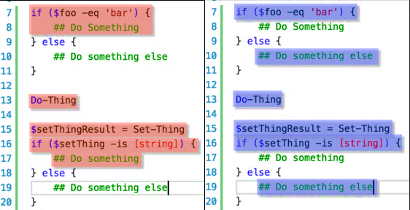
RECOGNIZING CODE PATHS

Slide 14
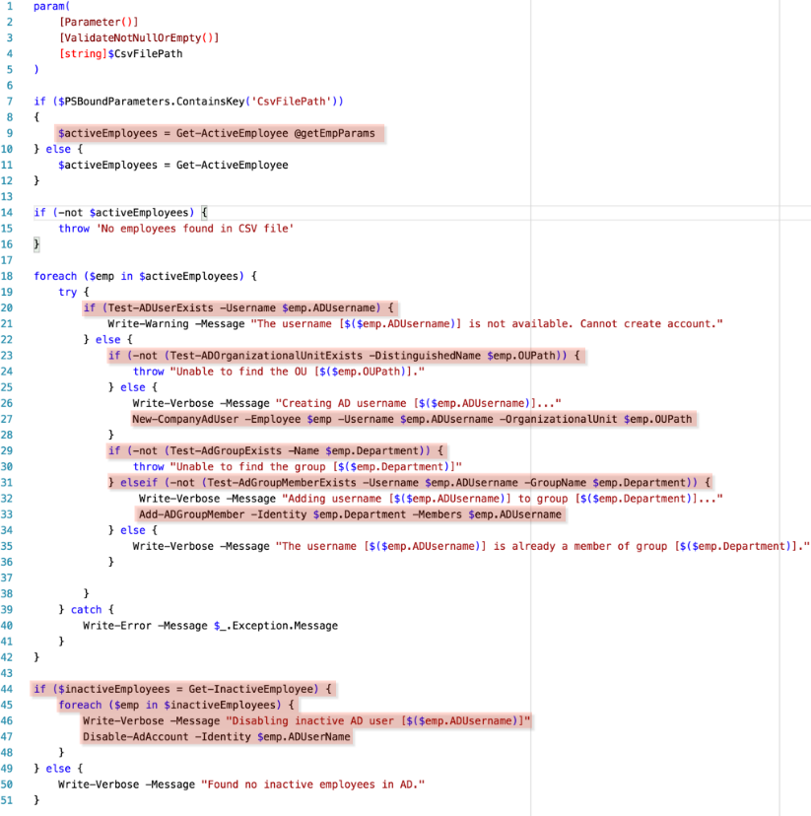
LONG CODE PATHS

Slide 15
MOCKING
"OVERWRITES"
FUNCTIONS
ALLOWS CONTROL OVER CODE EXECUTION
ENABLES COMMAND ASSERTIONS
CRITICAL TO PROPER UNIT TESTING
SEE CHRIS
HUNT'S SESSION

Slide 16
DEMO:
MOCKING

Slide 17
WHAT WE’VE LEARNED
1
2
3
4
DIFFICULT
TO GET
STARTED
FORCE BETTER
CODE
GROW
TRUST
TURNS “SCRIPTS”
INTO CODE

Slide 18
DEMO RESOURCES
GITHUB: bit.ly/PSSummit17UnitTesting

Slide 19
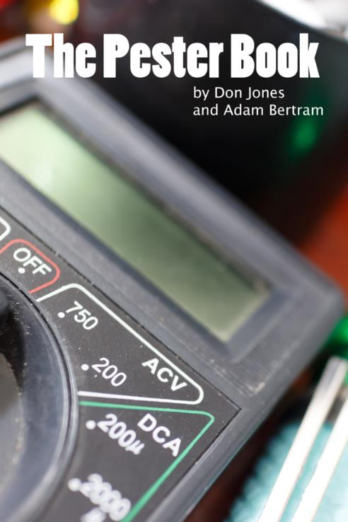
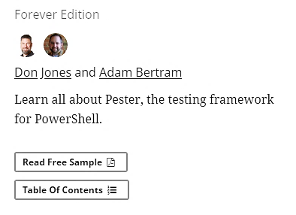
THE PESTER BOOK
https://leanpub.com/the-pester-book

Slide 20

GET AHOLD OF ME :
Adam Bertram
@adbertram www.adamtheautomator.com

Slide 21
THANK
YOU

